Slide 1
Tikvenik (Тиквеник)
Bulgarian traditional desert
Antoaneta Toncheva

Slide 2
recipe
1 package of dough
1/2 cup butter
3 cups pumpkin puree
3/4 cup packed brown sugar (for a less sweet version, reduce the brown sugar to 2/3 cup)
3/4 cup coarsely ground walnuts
2 teaspoons cinnamon
1/2 teaspoon ground nutmeg
1/2 teaspoon dry orange zest (optional)

Slide 3
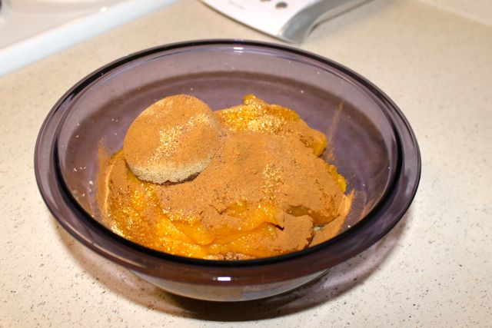
Method of preparation
Preheat oven 190 degrees Celsius.
In a medium-sized bowl, mix together the pumpkin puree, brown sugar, walnuts, cinnamon, nutmeg, and orange zest.
These yummy ingredients are going to be the filling for your pastry.
In a small microwave-safe bowl, melt the butter.
using my large baklava pan.

Slide 4
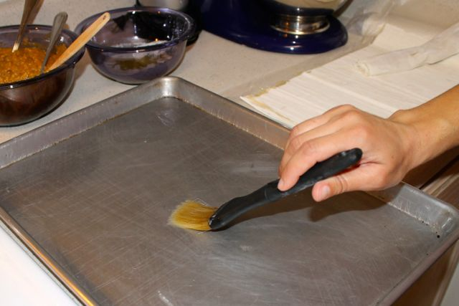
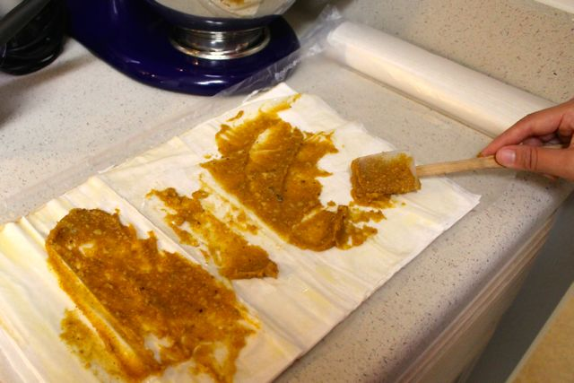
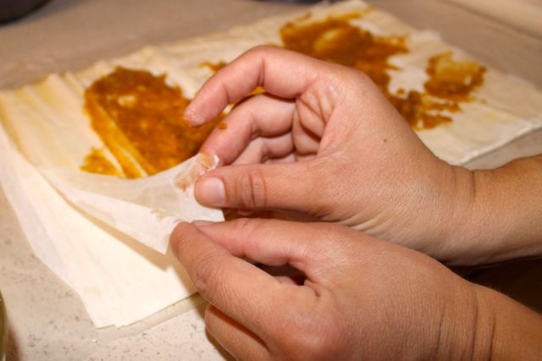
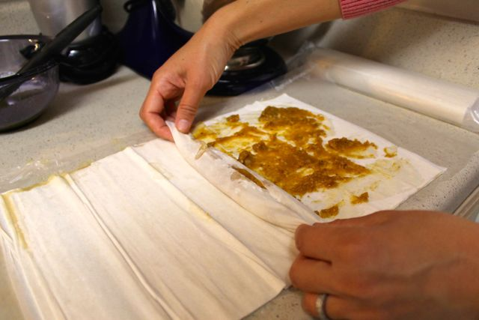
Тake about 2 tablespoons of the pumpkin mixture and gently spread it across the sheet, using a spoon or a small spatula. You do not need to cover every square inch of the sheet.

Slide 5
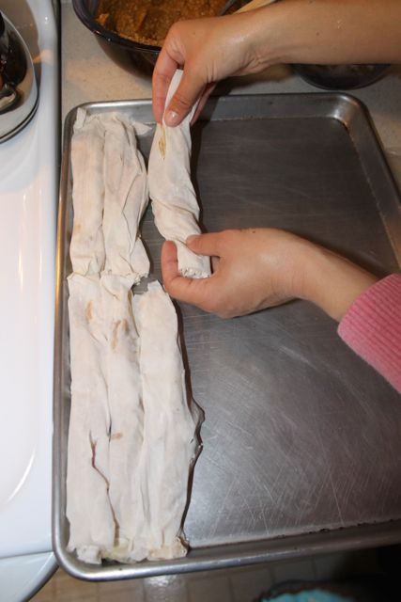
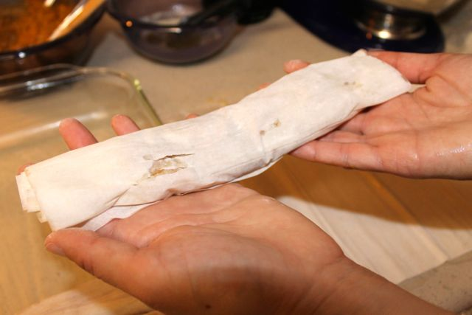
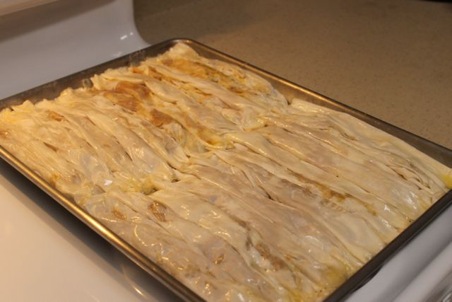
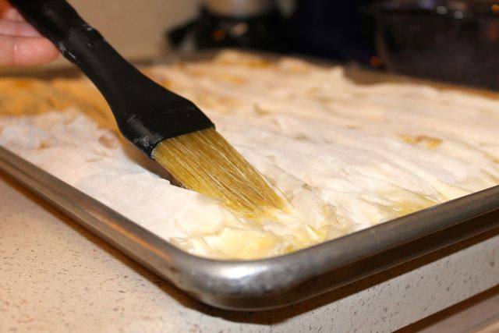
Мelt about 1 tablespoon butter.

Slide 6
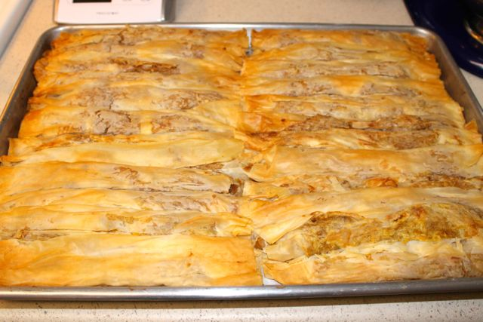
Ready for eating! ☺
Bake the tikvenik for about 45 minutes, until it is golden brown.

Slide 7
Enjoy ☺
Thank you for your attention!

